Slide 1
How to navigate graduation at FIU
Mo Donnelly - Assoc. Dean – Fall, 2020

Slide 2
If you have questions:
Ask GPD/GPS
Ask Mo (CASE)
Ask Mery Castro (CASE)
maureen.a.donnelly@gmail.com
mejiam@fiu.edu

Slide 3
ESSENTIAL Websites:
https://case.fiu.edu/about/resources/
current-students/graduate-students/
index.html
gradschool.fiu.edu
libguides.fiu.edu/etd

Slide 4
STEP 1: SELECT THE DEFENSE DATE
1. You need to select a defense date, time,
and place. All defenses in Fall, 2020 will be held
remotely over Zoom.
3. The defense must be public, it must be advertised, and it must occur during normal business hours. No Holidays or weekends.
4. Make sure committee members have the rubrics required for the thesis & seminar: https://case.fiu.edu/about/resources/
current-students/graduate-students/
index.html.
5. Explain Rubrics

Slide 5
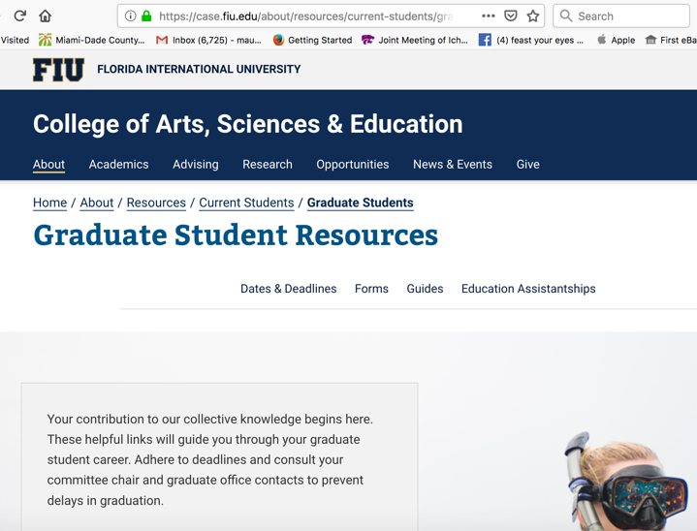

Slide 7
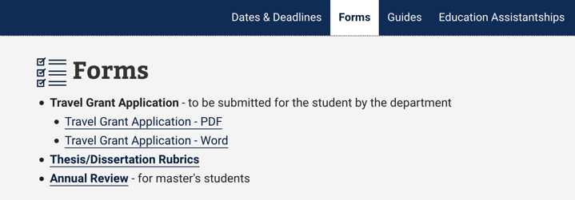

Slide 9
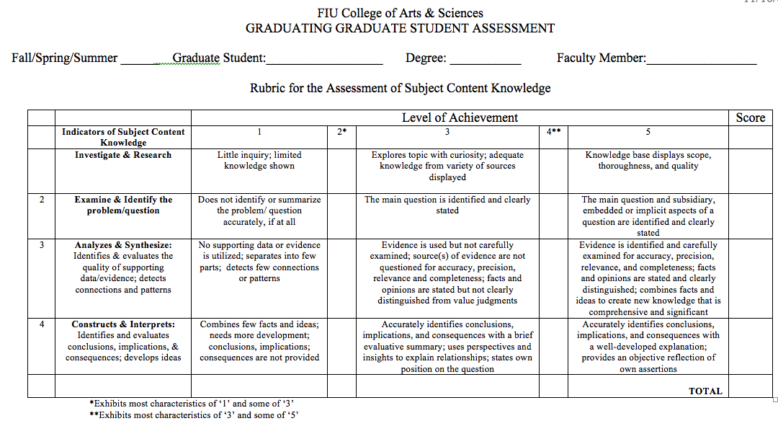

Slide 10
STEP 2: DEVELOP THE TIMELINE
Figure out the timeline and due dates:
UGS - 3 weeks before defense
CASE - 4 weeks before defense
GPD - 5 weeks before defense***

Slide 13
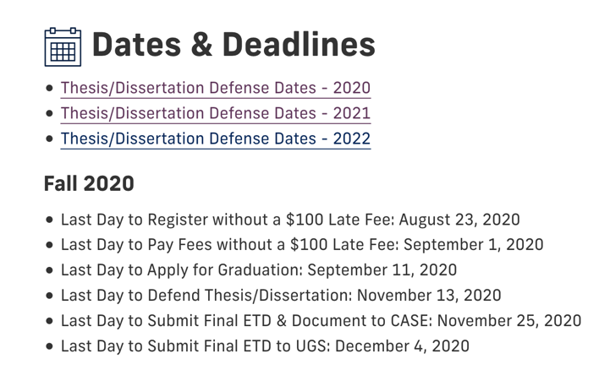
ETD due CASE 25 November 2020

Slide 14
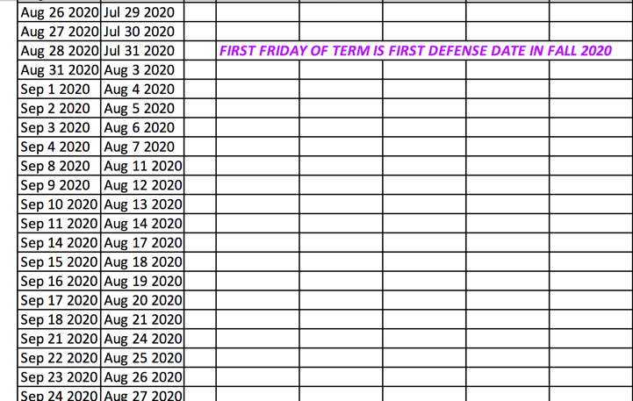

Slide 15
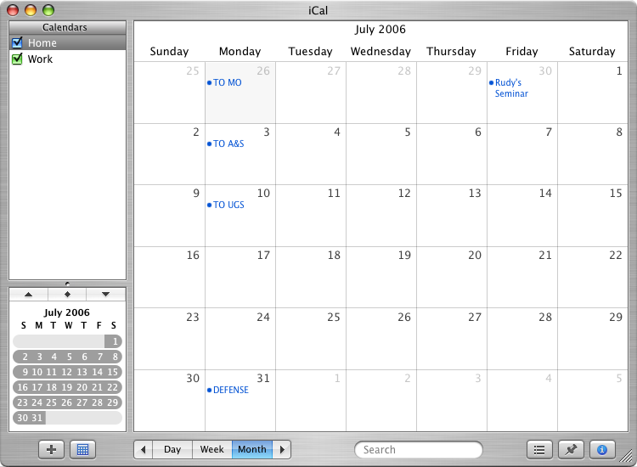
Defense Date

Slide 16
Due Date I - UGS

Slide 17
Date II - A & S

Slide 18
Date Due III - To GPD

Slide 19
STEP 3: APPLY FOR GRADUATION, ETC.
You need to apply for graduation online
with Panthersoft. If you have applied before, you may need to go to the office and get reinstated.
The deadline for application is 11 Sept 2020.
You need to make sure you have enough
credits and fulfilled all requirements. Work with your GPD/GPS. You need to make sure you have no Incomplete grades on your transcript, fulfilled all requirements and your GPA is 3.0 or better.
You need to make sure you have enrolled
or are enrolled in Defense Seminar if required.

Slide 20
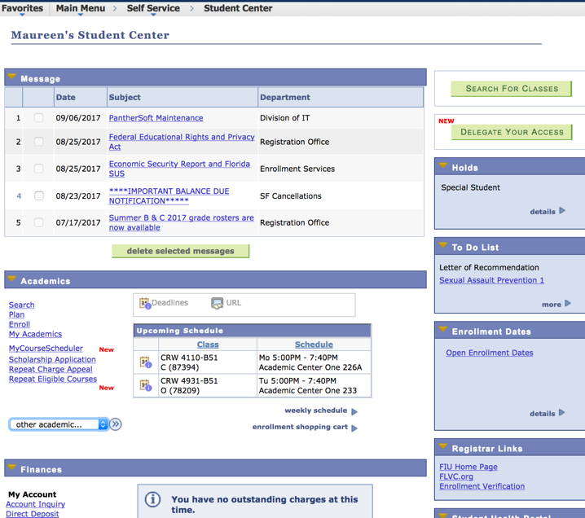
PDA Check &
Application for Graduation is a Panthersoft Function

Slide 22
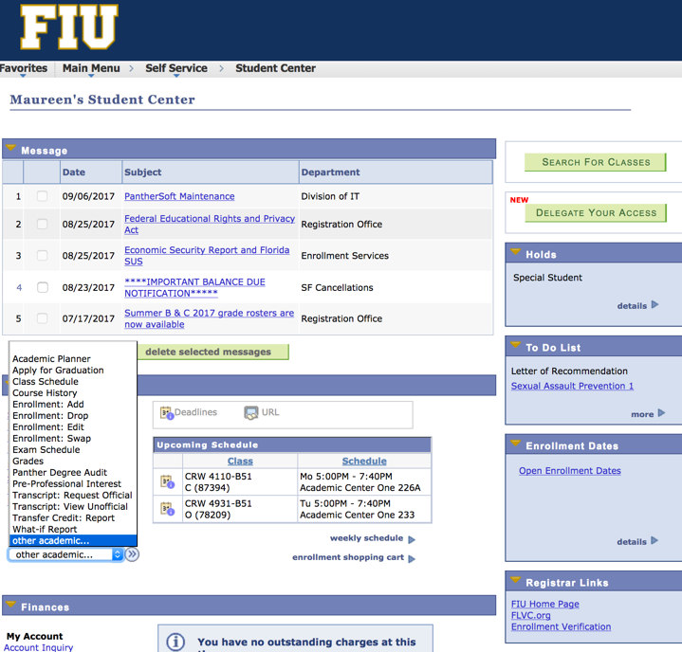

Slide 24
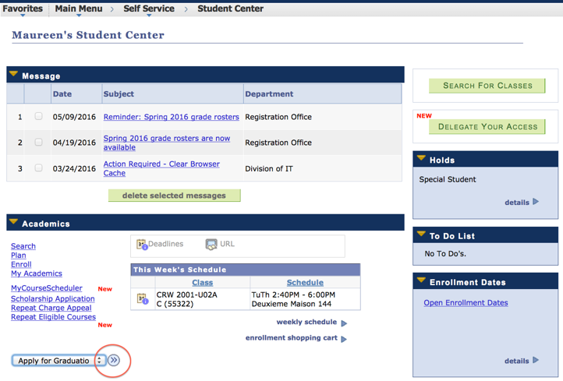

Slide 25
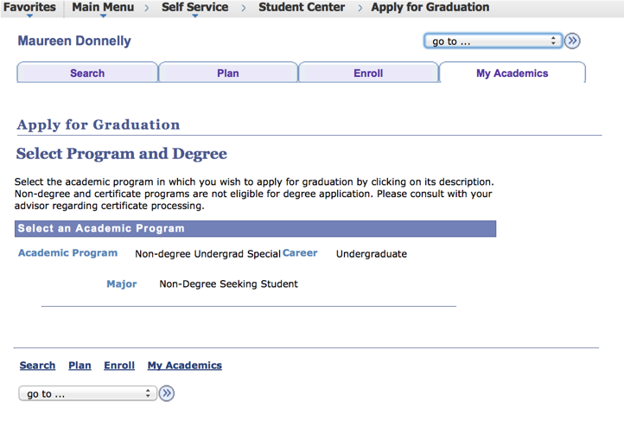

Slide 26
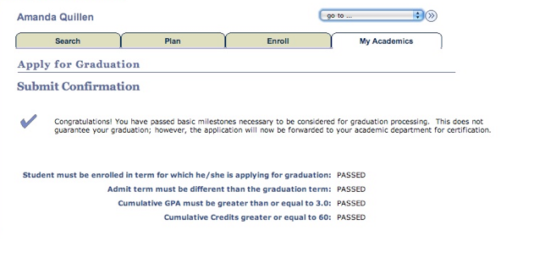
Four criteria must be met to process
application for graduation:
Enrolled in current semester
Admit Term not equal to Grad Term
Cum GPA > 3.0
***Cum Credit (PhD) > 60

Slide 27
The last day to defend
for FALL 2020 is:
13 NOVEMBER 2020
STEP 4: DEFENSE DEADLINES

Slide 28
STEP 5: THESIS TO COMMITTEE
The version you turn in to the University must be in the proper, final University Format. Copyright release.
The formats are all explained at the UGS website.
http://gradschool.fiu.edu/electronic-thesis-dissertation.shtml

Slide 29
Page ii – Signature Page & Forms
Prepare Page ii (no signatures)
Signatures are no longer required, but page ii is required. It must conform to UGS guidelines
MAKE SURE UGS FORMS ARE CURRENT!!

Slide 30
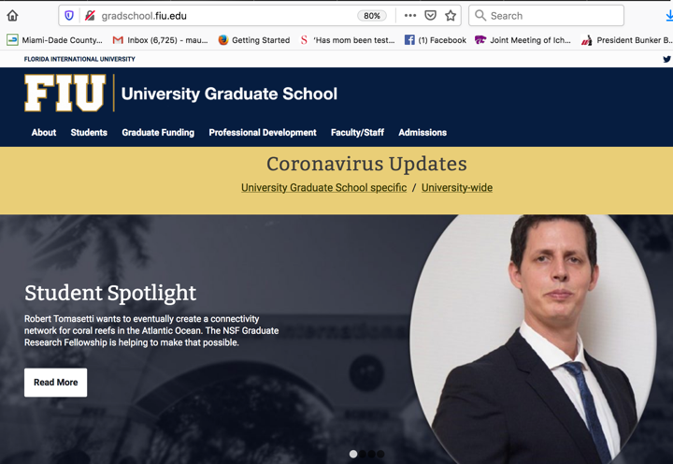
gradschool.fiu.edu

Slide 31
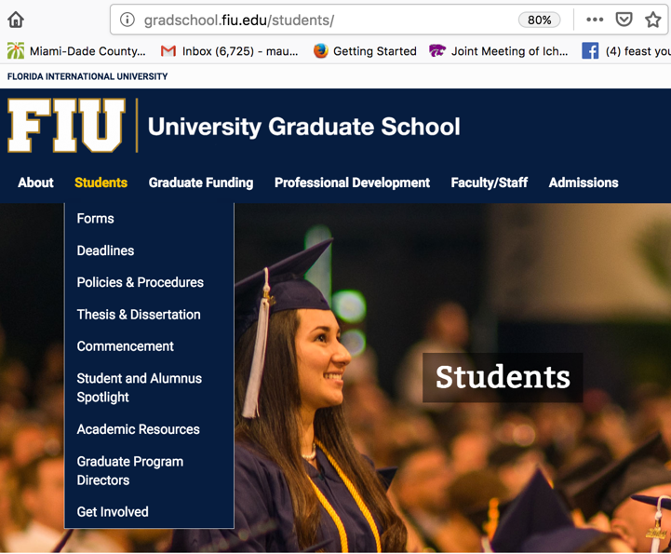

Slide 33
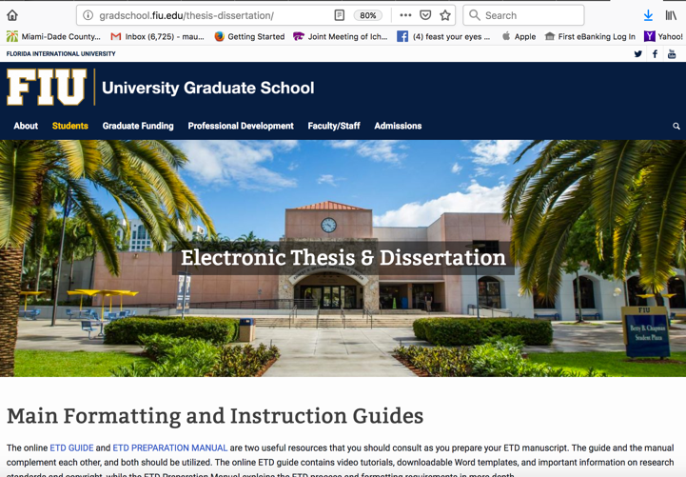

Slide 35
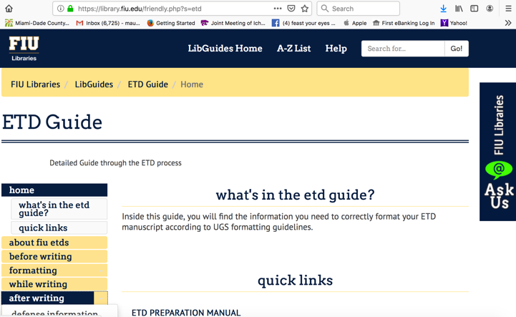

Slide 37
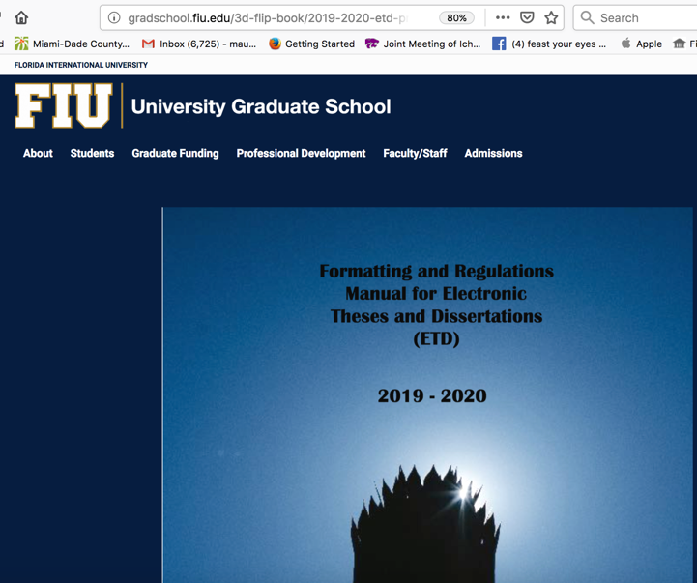

Slide 38
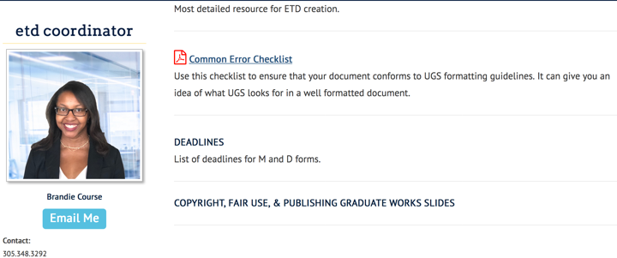
Brandie Course

Slide 39
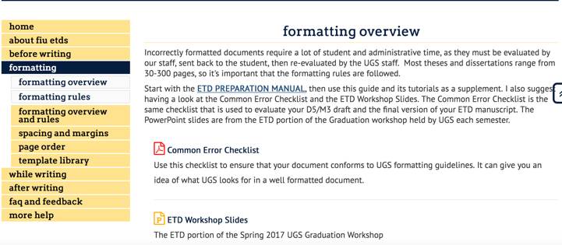

Slide 40
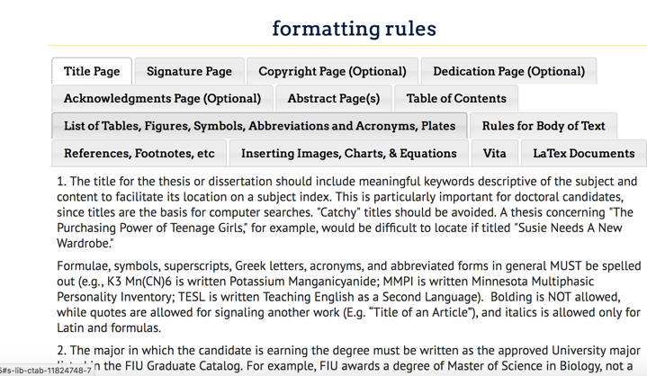

Slide 42
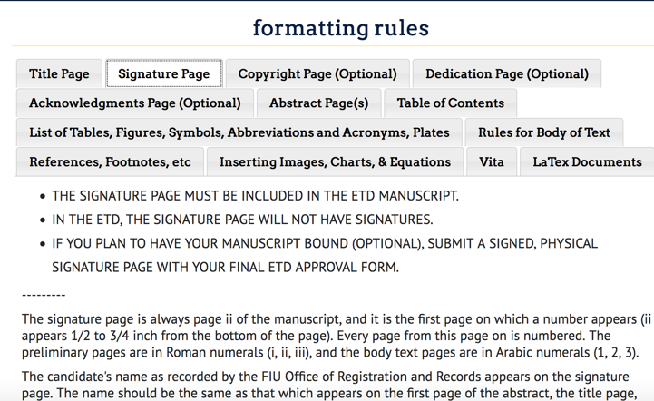

Slide 43
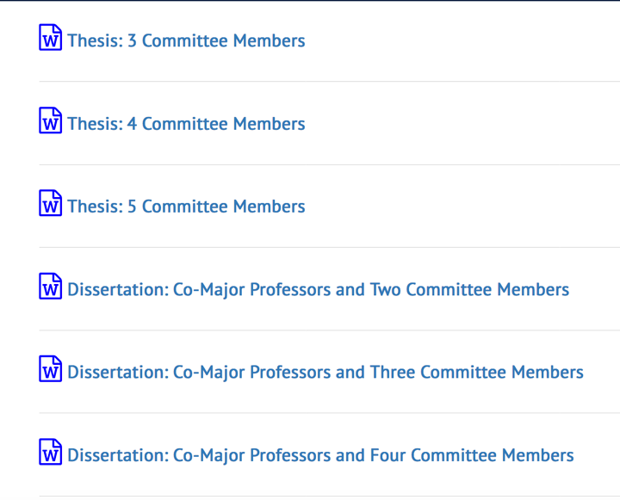

Slide 44
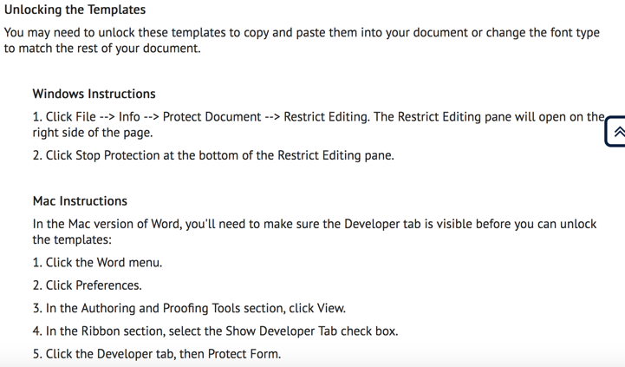

Slide 45
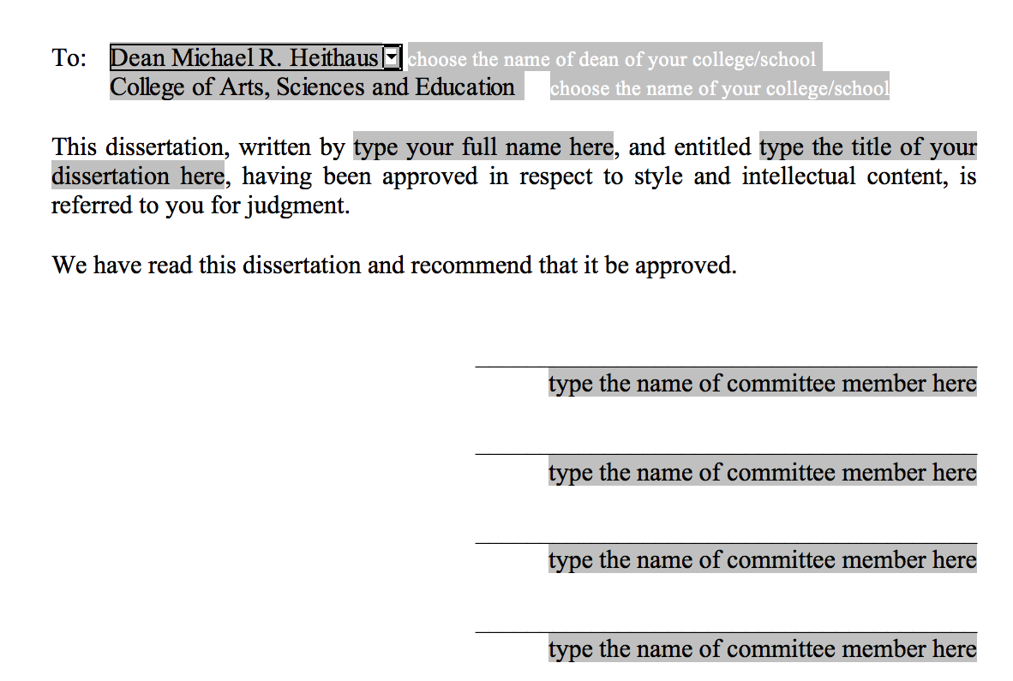
Michael R. Heithaus – Dean
College of Arts, Sciences and Education

Slide 46
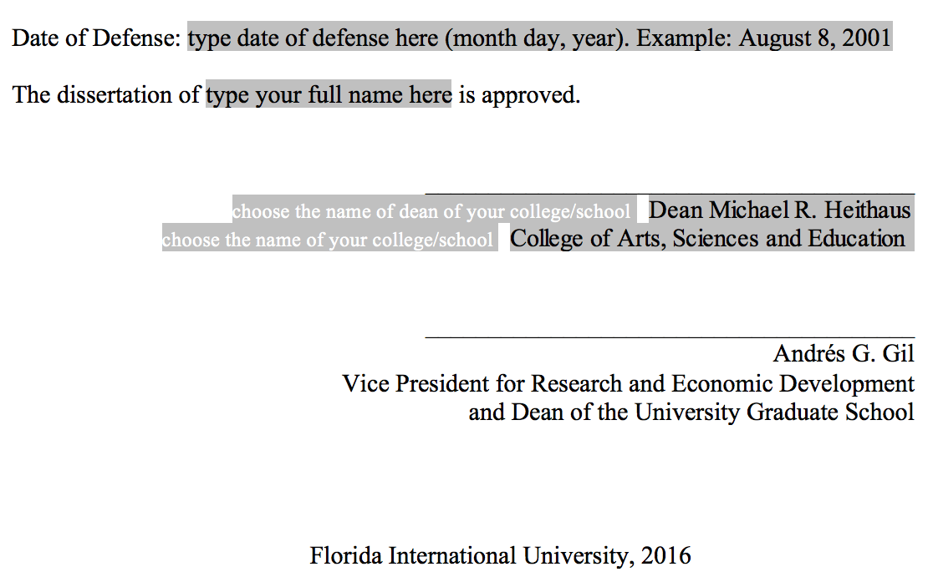

Slide 47
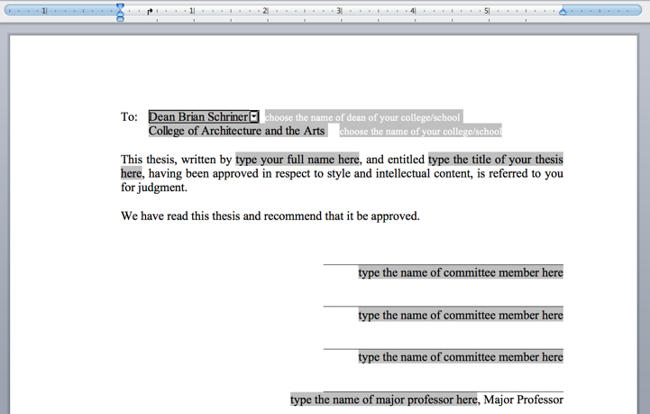

Slide 48
Title page does not have a page number

Slide 49
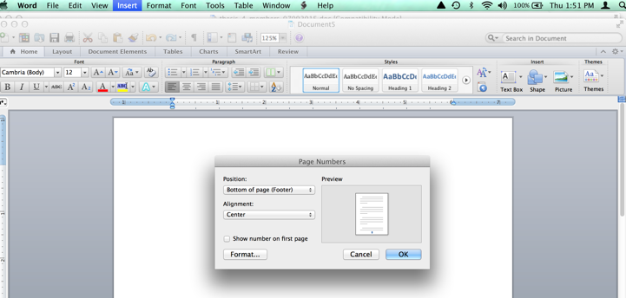
Click the box to delete page number

Slide 50
STEP 6: DEFENSE ANNOUNCEMENT
Once the details are finalized, you need
to prepare the defense announcement.
Send this announcement to the GPD and
the GP Secretary, and to CASE (mejiam@fiu.edu).
UGS also needs it when you submit M-3/D-5.
Announce the defense over your departmental
list servers.

Slide 52
To finish.........
Get Copyright Release from Journals. Get the instructions to authors from journals if format is odd. You must show UGS proof of format if you use journal formats.
The committee members must sign M3/D5 (says the documents is defensible).
The document, form, and announcement are due to the GPD. GET DEADLINE FROM DEPT. GPD.
Materials are read by me in CASE.
Share the defense with your department.

Slide 53
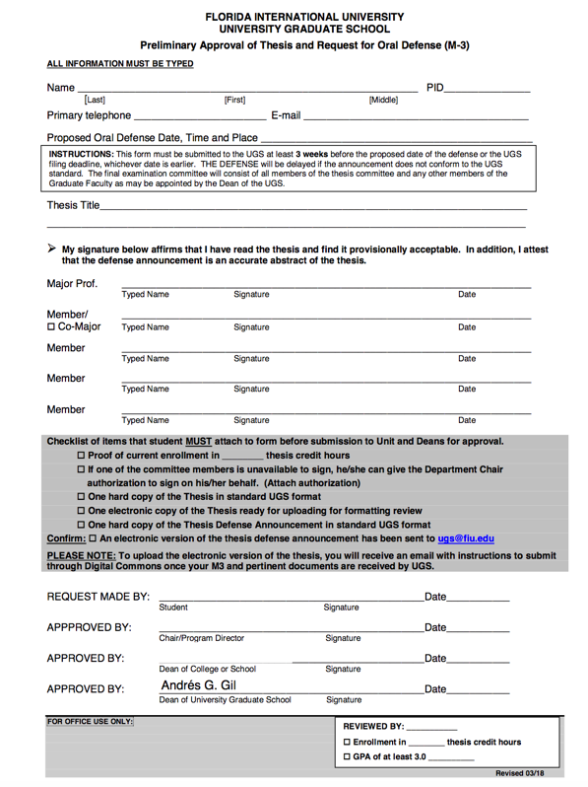

Slide 54
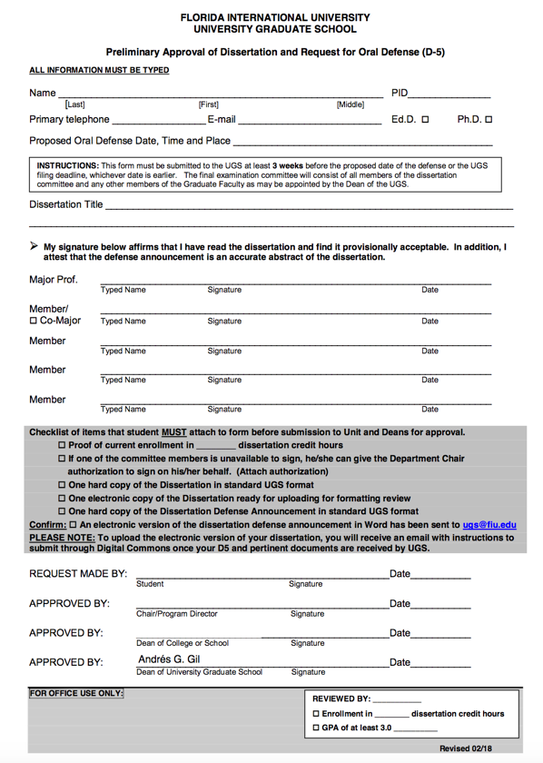

Slide 56
Hi Student,
Congratulations on finishing your thesis and having two of your chapters published.
The "How to Graduate – SUMMER 2020" is posted on the college website
Please send an electronic version of your defense announcement to Mery Castro (mejiam@fiu.edu) so we can post it on the CASE website and University Webmail site. Please pay attention to the following deadlines for SUMMER 2020 graduation.

Slide 57
We need an electronic version of the dissertation or thesis as does UGS. You will work with Brandi Course at UGS
I look to document over to ensure that it is actually defensible; if there is a problem, I will contact you via email & phone. Make sure the M3/D5 has “live” contact info.
Your committee may require additional changes to the document before the final version is submitted. The M3/D5 version is not a draft; follow format rules. Be proud of your work.

Slide 58
Writing Tips:
Avoid “This/These/It” - be specific.
Avoid the use of Due to -- Rent is Due, your Thesis is Due, your dissertation is Due -- everything else is the result of something, because of something, or the consequence of something.
Avoid “based on” - usually you mean on the basis of. The verb “to base” is overworked.
Sentences begin and end with words - not symbols, numerals, abbreviations, or acronyms**
Avoid contractions in formal writing.
Watch Comparatives (more than ?, less than ?, equal to what?, better than what?).
Avoid starting sentences with conjunctions.
Datum is; data are
i.e., and e.g., always take a comma
et al. is abbreviation for et alia (al. takes a period). Et cetera is abbreviated with etc. – it also takes a period.
Avoid Orphan Headings – need one line of text per heading.
Read it out loud—your ears are good editors!

Slide 59
Seminar Presentation &
the rest of it.........
Practice, practice, practice (6Ps).
Make sure committee members have the rubrics (CASE website).
MP submits Rubrics to GPD not CASE.
Defend. Circulate the form to your Major Prof & Committee members.
Make sure you have final ETD signature form and sign both pages.
Move the final ETD packet to the GPD.
I need a final electronic copy of the dissertation to look at one more time for format.
MAKE SURE FORMS ARE CURRENT

Slide 60
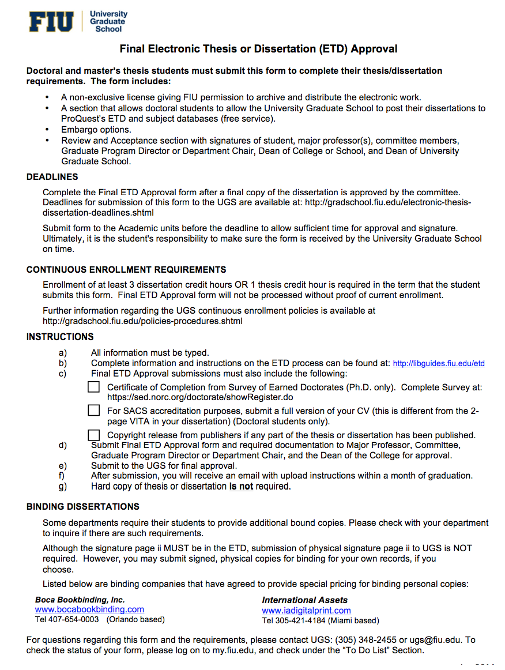

Slide 61
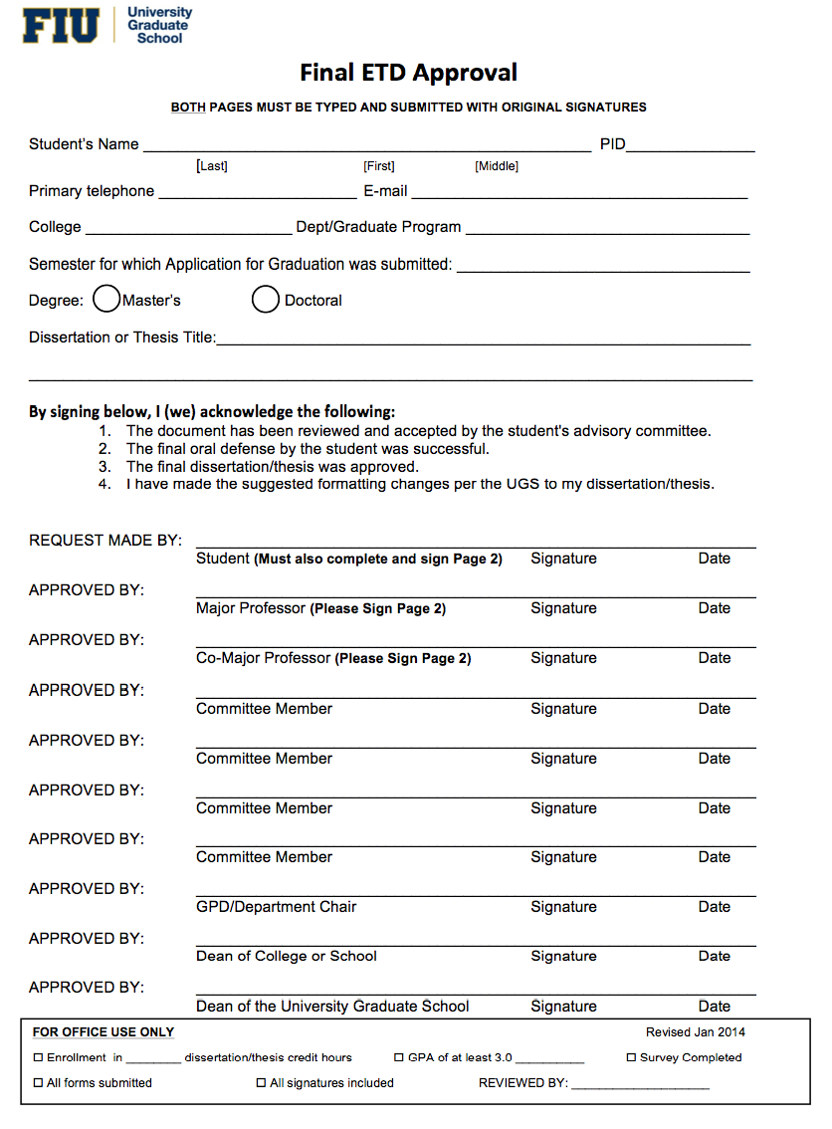

Slide 62
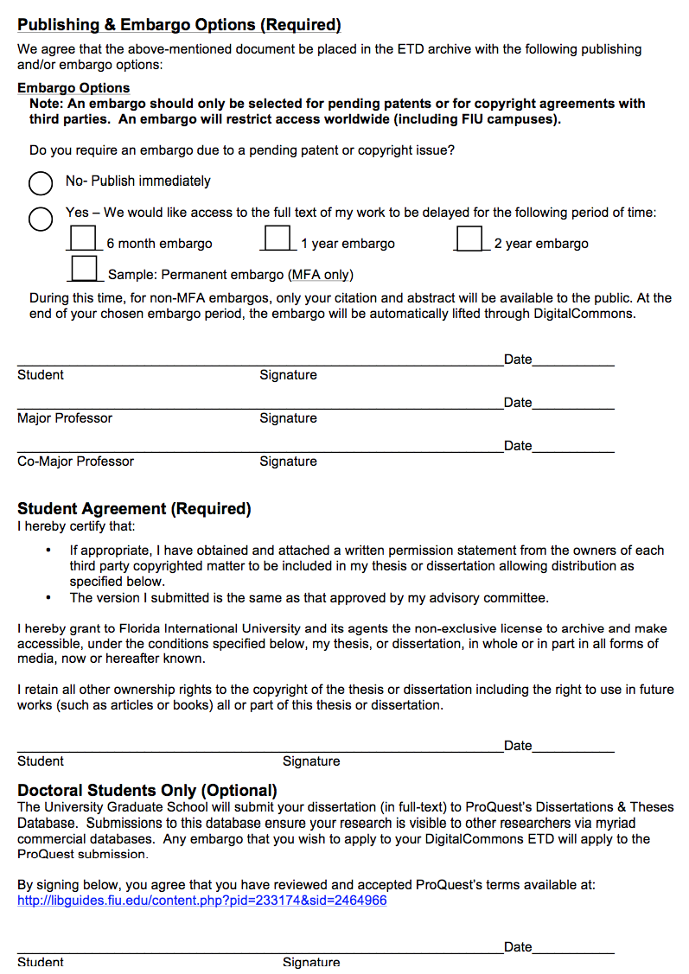

Slide 63
embargo
If you wish to have a permanent embargo on the thesis/dissertation, you must submit a petition to graduate requirements.

Slide 64
After you finish the revisions........
Get the revisions to UGS as soon as you can after the defense to speed the process along.

Slide 65
After you finish the revisions........
Bindery: D&B (Hialeah) 305.885.5215
Boca Book Binding: http://www.bocabookbinding.com/
http://www.lulu.com
http://www.phdbookbinding.com

Slide 66
Document Deadlines........
Final ETD form and final documents are due: Check with GPD
Final ETD form and final documents due to CASE on 25 NOVEMBER 2020.
i will look the document over for any format errors and I will move the Final ETD package to UGS for you.
Final ETD form and final documents are due to UGS on 4 DECEMBER 2020.

Slide 67
Questions?

